Slide 1

Multiple Access
Copyright © The McGraw-Hill Companies, Inc. Permission required for reproduction or display.

Slide 2
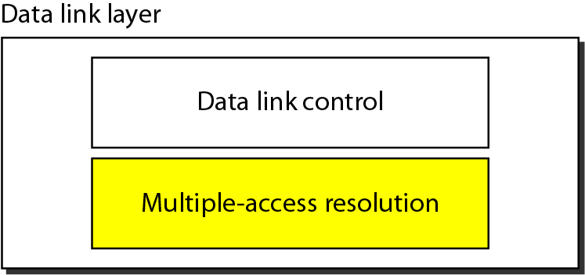
Figure 12.1 Data link layer divided into two functionality-oriented sublayers

Slide 3
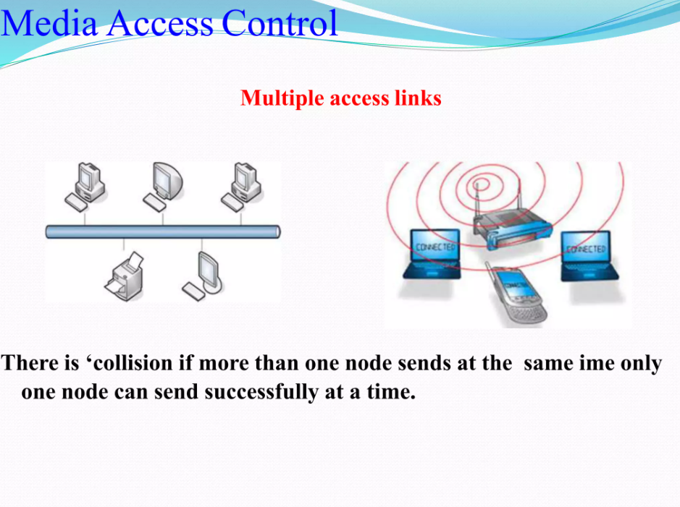

Slide 4
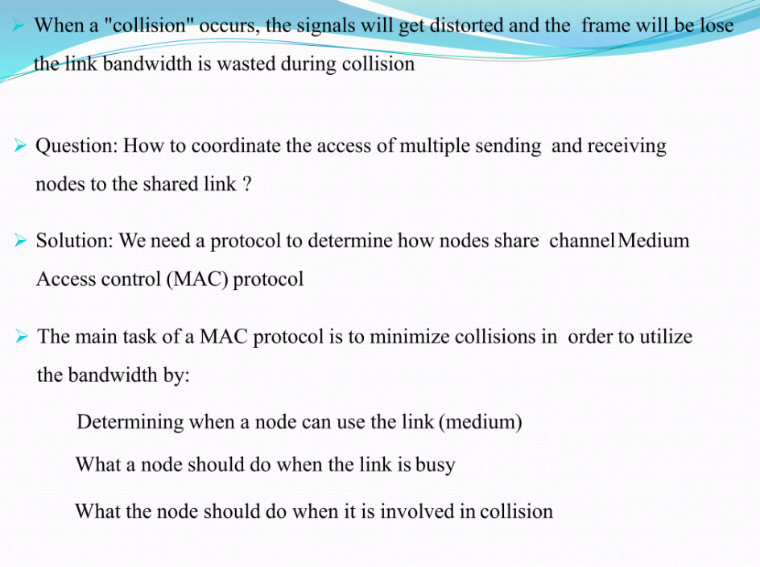

Slide 5
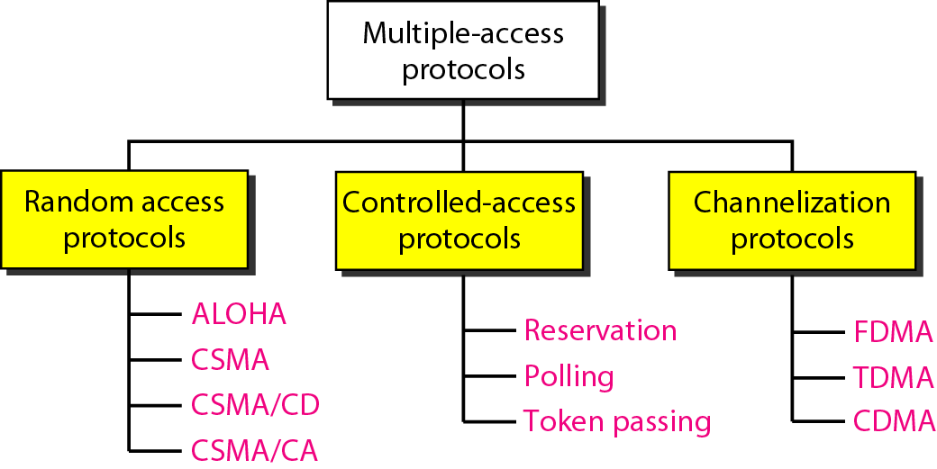
Figure 12.2 Taxonomy of multiple-access protocols discussed in this chapter

Slide 6
12-1 RANDOM ACCESS
In random access or contention methods, no station is superior to another station and none is assigned the control over another. No station permits, or does not permit, another station to send. At each instance, a station that has data to send uses a procedure defined by the protocol to make a decision on whether or not to send.
Topics discussed in this section:
ALOHA Carrier Sense Multiple Access
Carrier Sense Multiple Access with Collision Detection
Carrier Sense Multiple Access with Collision Avoidance

Slide 7
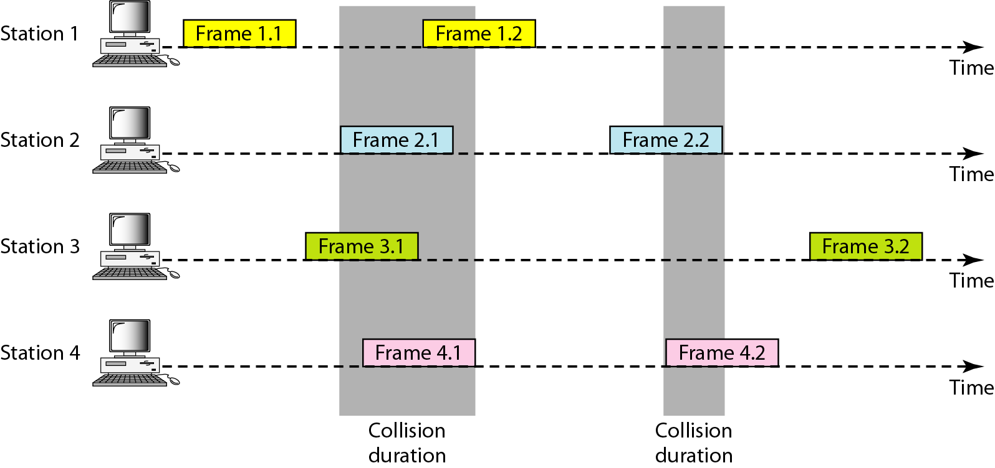
Figure 12.3 Frames in a pure ALOHA network

Slide 8
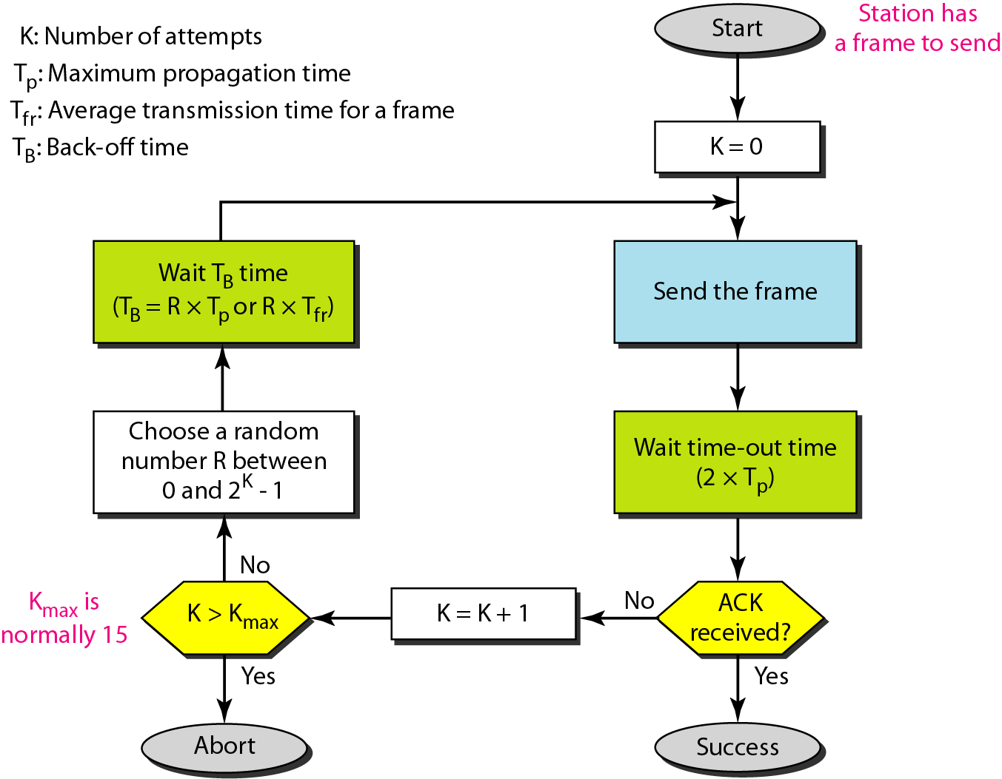
Figure 12.4 Procedure for pure ALOHA protocol

Slide 9
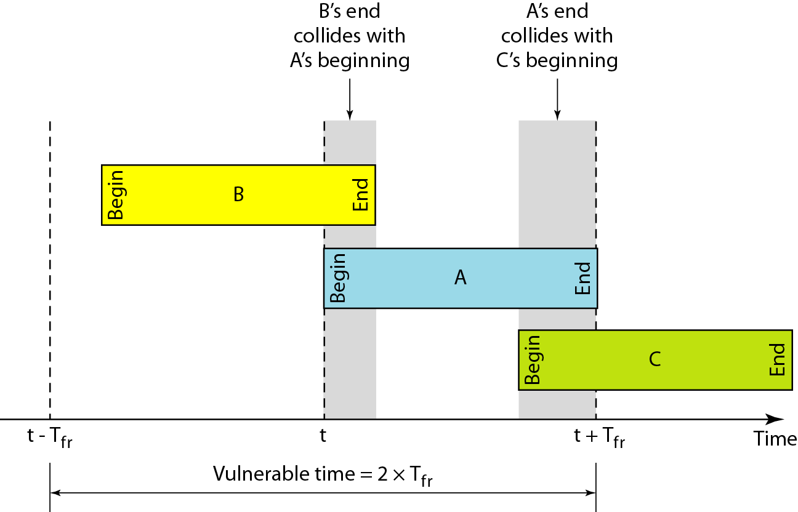
Figure 12.5 Vulnerable time for pure ALOHA protocol

Slide 10

Note
The throughput for pure ALOHA is S = G × e ^{−2G} .
The maximum throughput
S_{max} = 0.184 when G= (1/2).

Slide 11
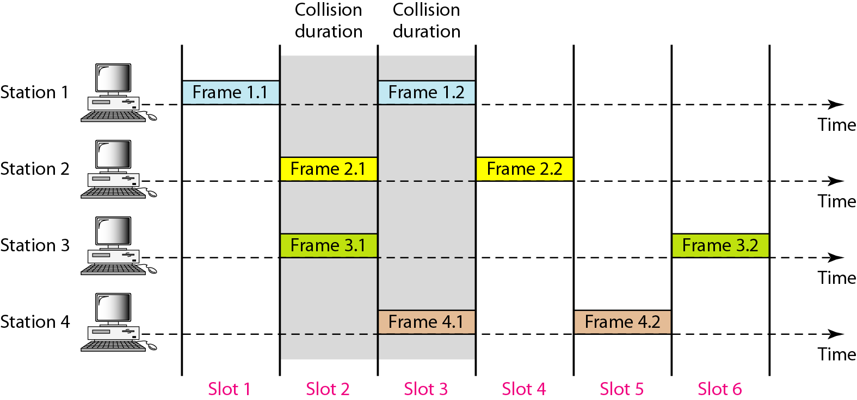
Figure 12.6 Frames in a slotted ALOHA network

Slide 12
Note
The throughput for slotted ALOHA is S = G × e^{−G} .
The maximum throughput S_{max} = 0.368 when G = 1.

Slide 13
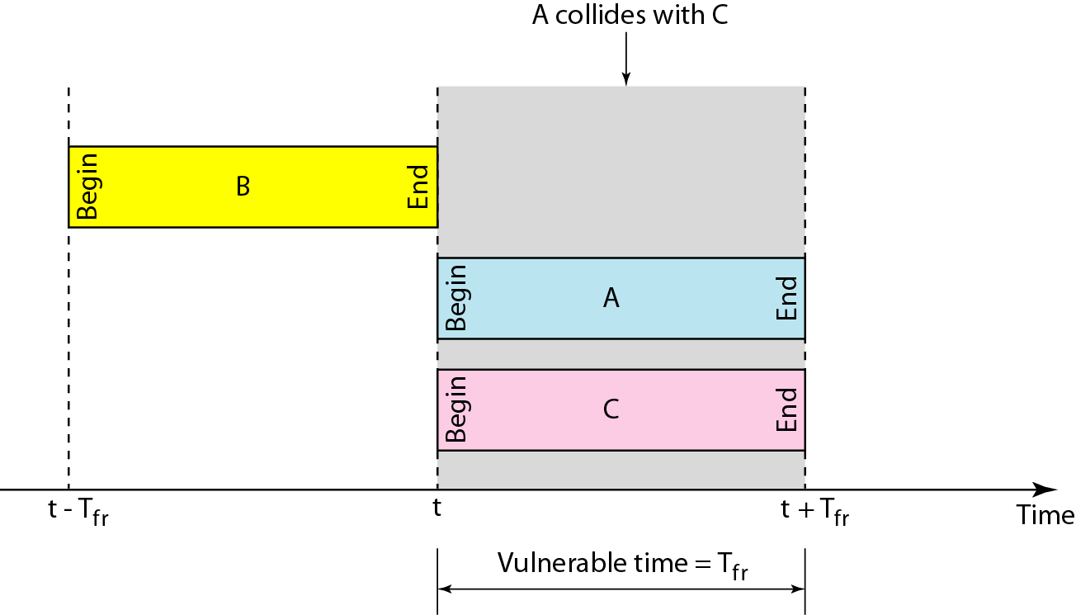
Figure 12.7 Vulnerable time for slotted ALOHA protocol

Slide 14
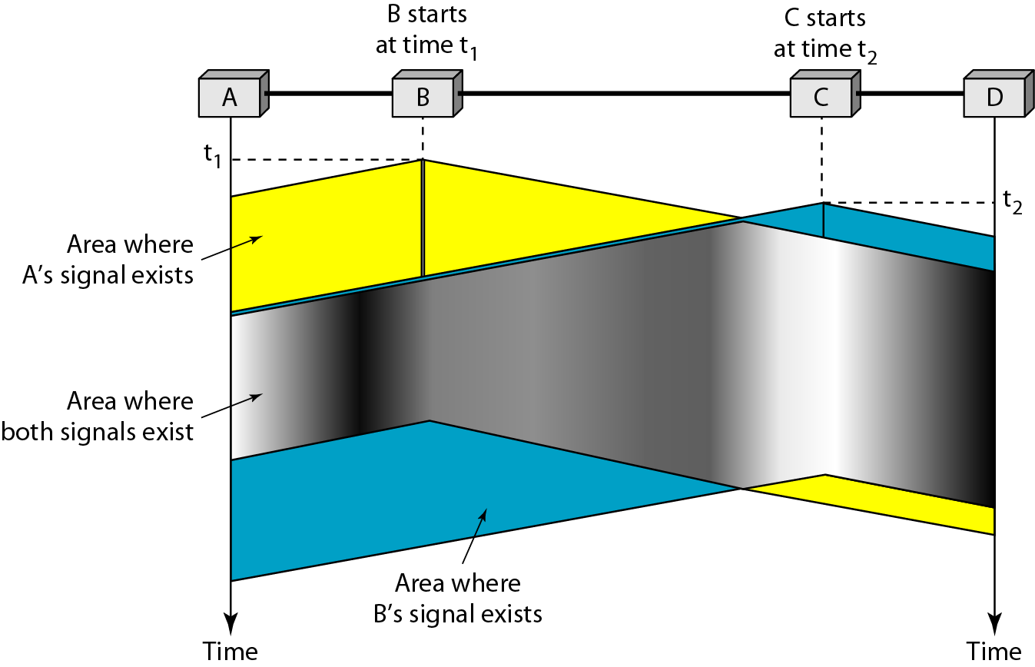
Figure 12.8 Space/time model of the collision in CSMA

Slide 15
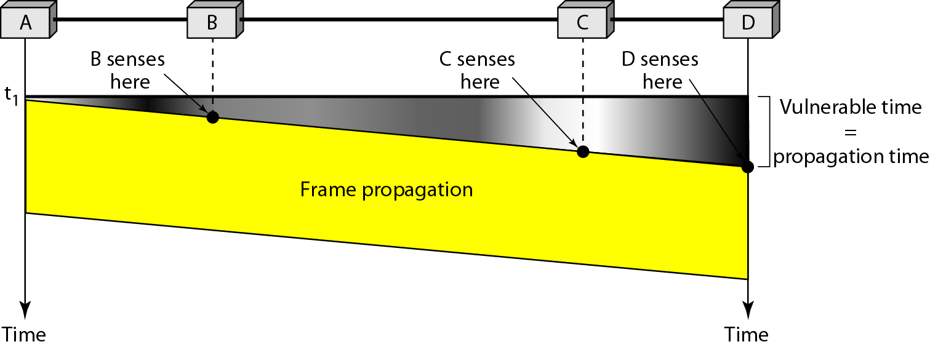
Figure 12.9 Vulnerable time in CSMA

Slide 16
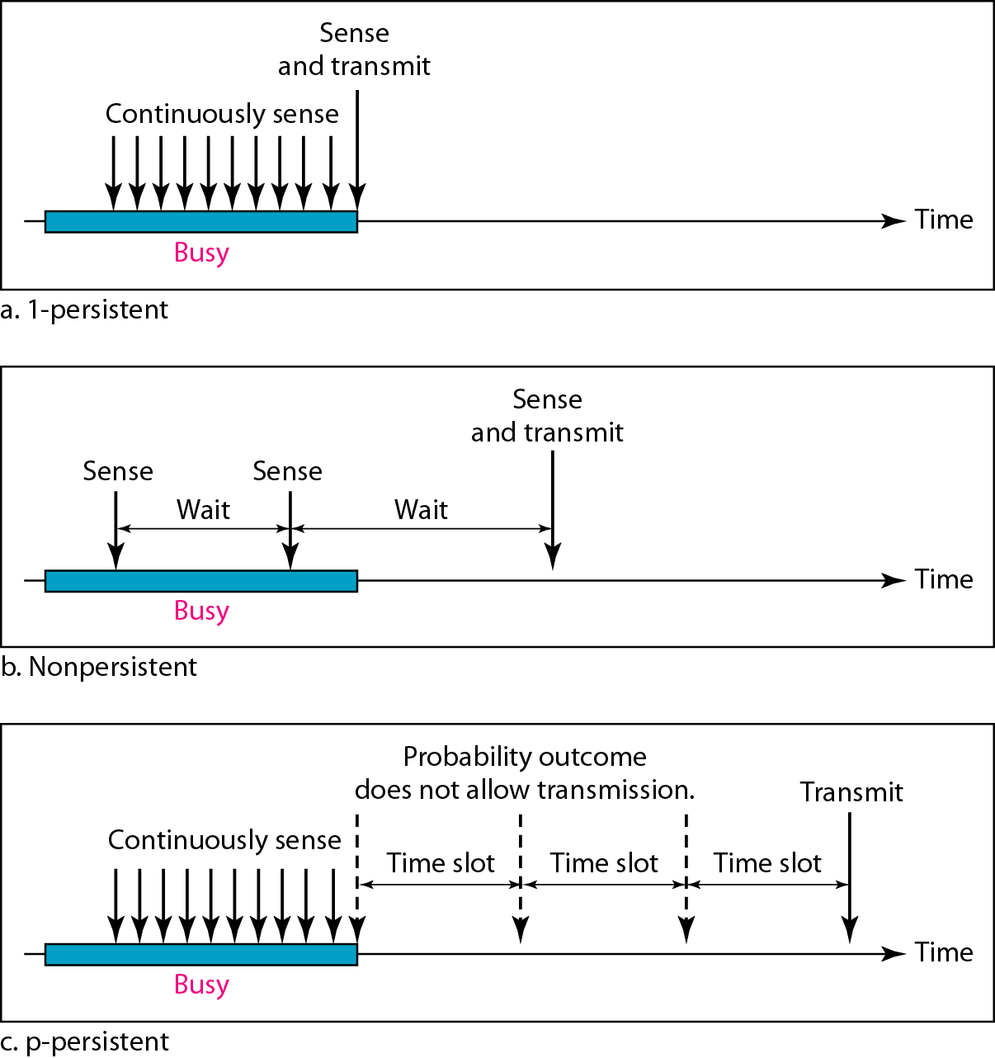
Figure 12.10 Behavior of three persistence methods

Slide 17
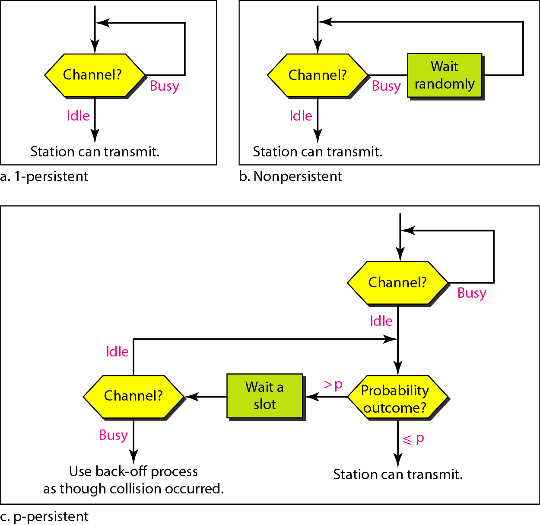
Figure 12.11 Flow diagram for three persistence methods

Slide 18
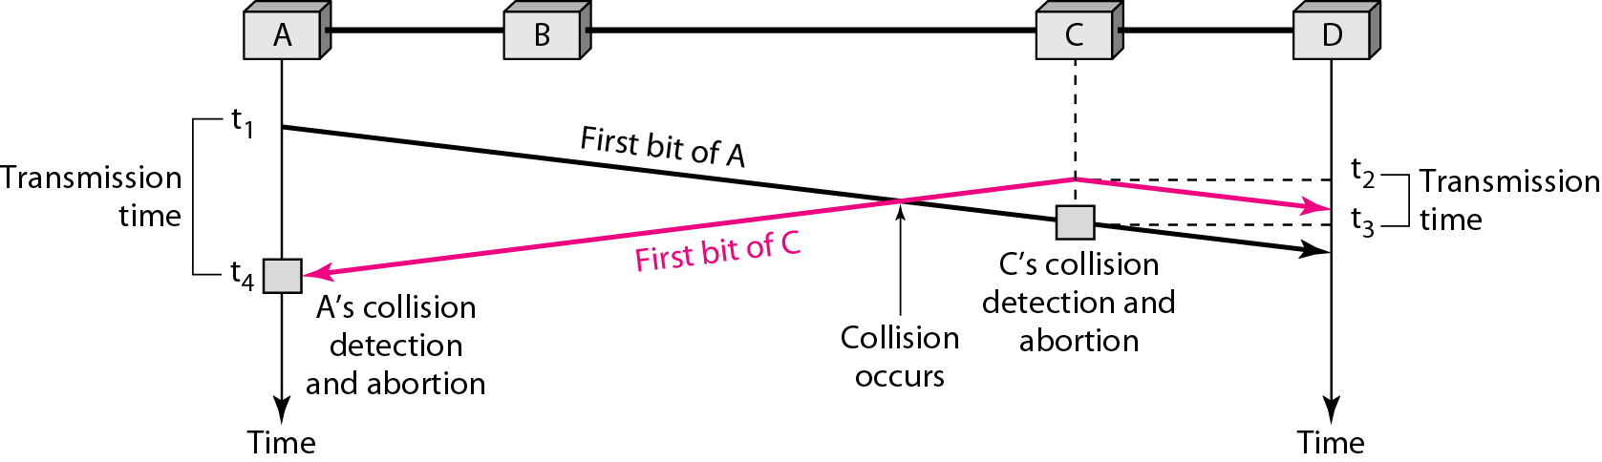
Figure 12.12 Collision of the first bit in CSMA/CD

Slide 19
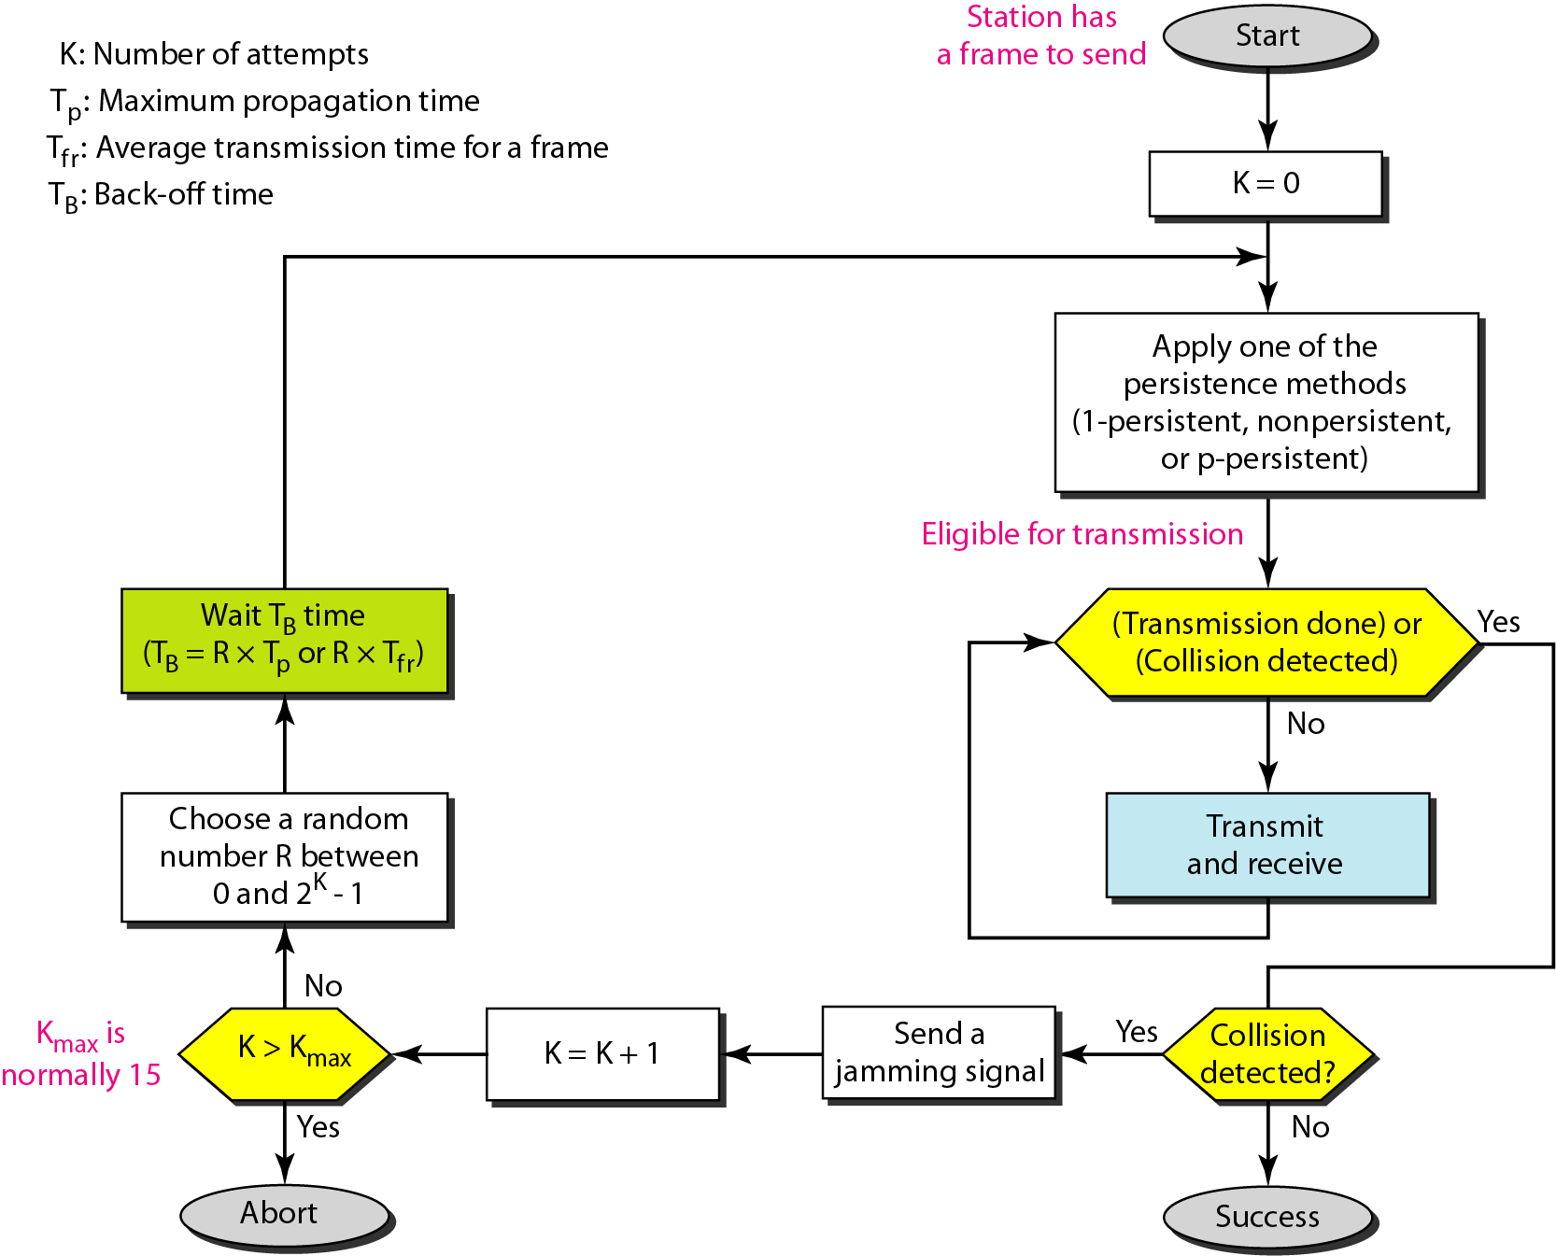
Figure 12.14 Flow diagram for the CSMA/CD

Slide 20
Note
In CSMA/CA, the IFS can also be used to define the priority of a station or a frame.

Slide 21
Note
In CSMA/CA, if the station finds the channel busy, it does not restart the timer of the contention window;
it stops the timer and restarts it when the channel becomes idle.

Slide 22
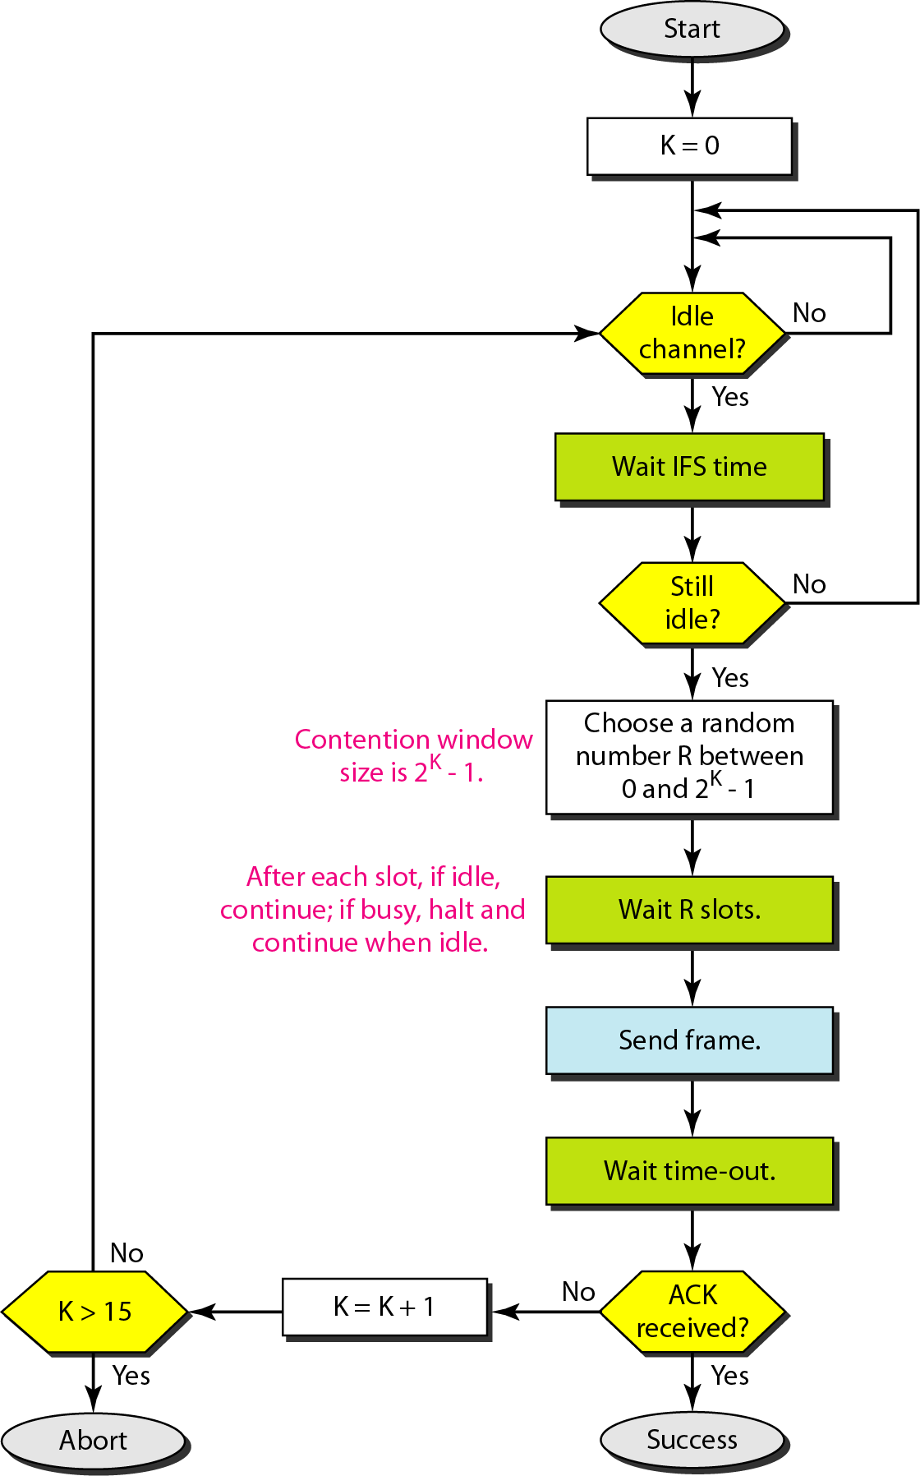
Figure 12.17 Flow diagram for CSMA/CA

Slide 23
Numericals (Refer Chapter 12)
Q1. The stations on a wireless ALOHA network are a maximum of 600 km apart. If we assume that signals propagate at 3 x 10⁸ mis, we find Tp = (600 x 105) / (3 x 108) = 2 ms. Now we can find the value of TB for different values of K. [For K =1,2,3]
Q2. A pure ALOHA network transmits 200-bit frames on a shared channel of 200 kbps. What is the requirement to make this frame collision-free?
Q3. A pure ALOHA network transmits 200-bit frames on a shared channel of 200 kbps. What is the throughput if the system (all stations together) produces
_{a. 1000 frames per second}
_{b. 500 frames per second}
_{c. 250 frames per second}
Q4. A slotted ALOHA network transmits 200-bit frames using a shared channel with a 200-kbps bandwidth. Find the throughput if the system (all stations together) produces
_{a. 1000 frames per second}
_{b. 500 frames per second}
_{c. 250 frames per second}
Q5. A network using CSMA/CD has a bandwidth of 10 Mbps. If the maximum propagation time (including the delays in the devices and ignoring the time needed to send a jamming signal, as we see later) is 25.6µS, what is the minimum size of the frame?

